Slide 1

HELLO EVERYONE
Game: CANDY CRUSH

Slide 2

How to Play Candy Crush
This Candy Crush guide provides all the basics on how to play Candy Crush Saga by King.com. Candy Crush is a matching game where you must swipe to match three candies of the same color to remove them. However, there are many other combinations other than the basic 3 that you will need to use in order to beat all the levels of Candy Crush. Learn everything you need to know about the gameplay of Candy Crush right here.

Slide 3
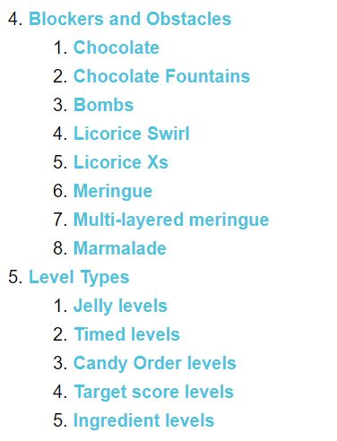
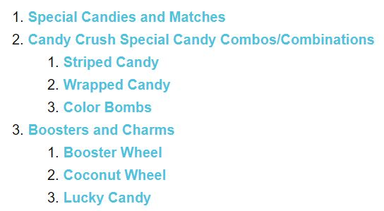
Candy Crush Saga Guide

Slide 4

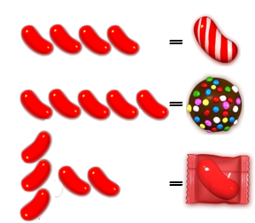
Candy Crush Special Candies and Matches
Learn about all the different basic moves you can make with the candies on your Candy Crush board. How to match 3 candies, 4 candies, and 5 candies together and what these different candy combinations will give you. These are all the basic Candy Crush tips for matching candies.

Slide 5
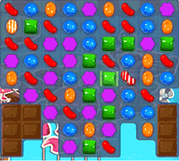
Candy Crush Special Candy Combos/Combinations
Combining two candies in
Candy Crush Saga makes special candy combos,
which are the most powerful matches in the game.
You can combine any two special candies together
to create a greater effect, whether it be a striped candy,
wrapped candy, or color bomb/sprinkled chocolate.

Slide 7
THANKS

